Slide 1
STREAMING
Architecture by Example

Slide 2

What
Why
How
Notes:
Joe Zack: * Coding Blocks
Software Engineer for Broadcom
Real-Time Analytics, I work with security events for very large organizations: Banks, Governments that have hundreds of thousands of computers, and billions of events. It's important to my customers that I detect problems as quickly as possible and I need to be able to quickly adapt when new threats are recognized.
Streaming is super cool, and worth your time
What
Why
How

Slide 3



Notes:
XP working with streaming data or real-time data/interfaces?

Slide 4
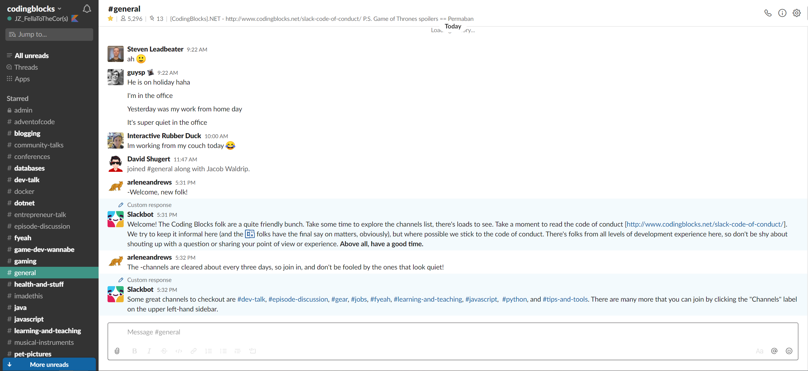
Notes:
XP working with streaming data or real-time data/interfaces?

Slide 5
Notes:
What about these experiences?
https://www.pexels.com/photo/smartphone-car-technology-phone-33488/

Slide 6
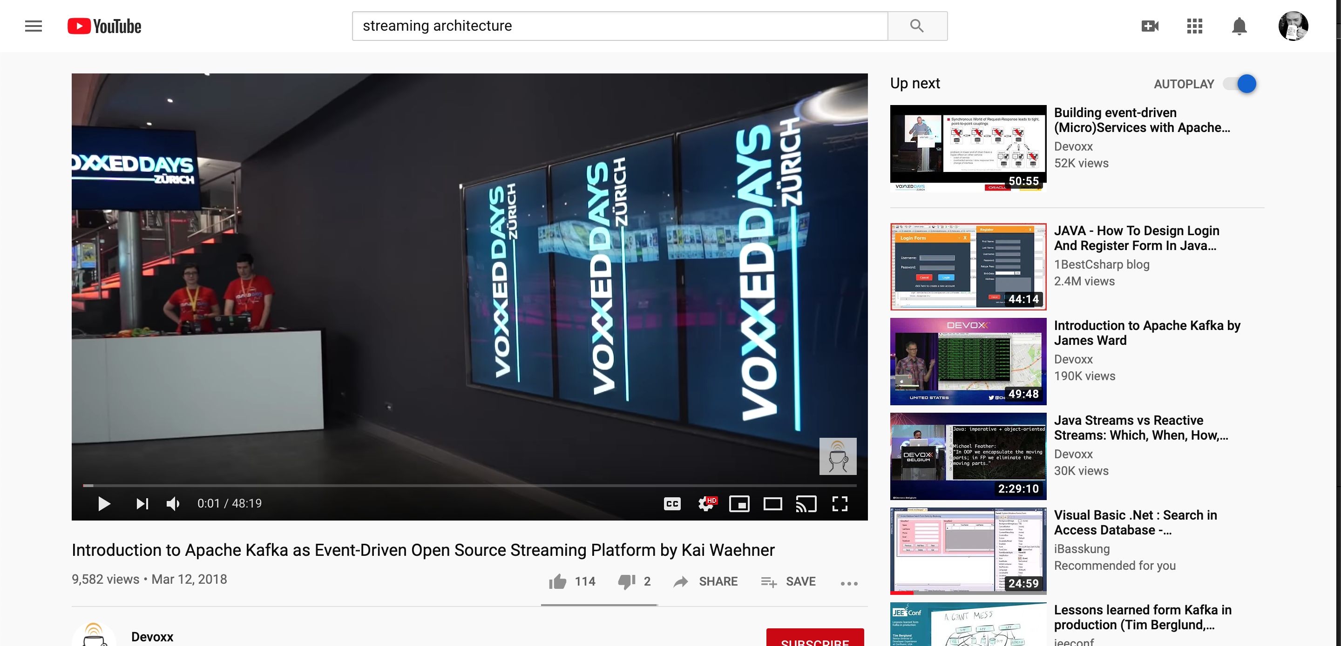

Slide 8
Notes:
The interfaces I showed you are only possible because of real-time data and the user interface techniques that enable it.
(Stocks in a newspaper)

Slide 9
Better UX
Better Broadband
Better Dev Tools
Better Data
Notes:
Downside: it’s difficult!
The good news is that the tooling is getting dramatically easier
More slides: 5g vs 1g
Better tools (Jaeger, Grafana)
Better Data – data explosion
How do we build them?
We have options!
Pub/Sub, Kappa Architecture
People do whole talks on this, it’s really enterprise—omplicated and expensive, and great – these are great if you’re building a gigantic product / core experience around streaming data
Today I want to focus in on a lighter weight version of these architectures called the 3 Factor App. It distills the spirit of these larger architectures into asmaller bite – fantastic for dipping your toe in, and it translates well into these other heavier architectures
3 Factor App is brought to us by the fine folks at Hasura, it’s an open-source project – and you can pay them to help you host it
We can find more info at 3factora.app but the gist is pretty simple:
1. Realtime Graphql – GraphQL subscriptions offer a convienient way to subscribe to data from a back-end service
2. Reliable Eventing - Storing an immutable event log
3. Async Serverless
Backend services capable of dealing with millions / second

Slide 10

Competing Consumers
Queue
Producers
Consumers
Notes:
https://docs.microsoft.com/en-us/azure/architecture/patterns/competing-consumers
Pros:
Scalability
Reliability
Load balancing
Cons:
Independent tasks

Slide 11
Pub / Sub
Topic
Producers
Subscribers (aka Consumer Groups)
Notes:
https://docs.microsoft.com/en-us/azure/architecture/patterns/publisher-subscriber
Except that subscribers observe an event instead of consuming it. This allows consumers for different purposes.
Specialized jobs that filter, aggregate, subscribe to multiple topics, end up with a service bus

Slide 12
One-At-A-Time / Functional Processing
Filtering, Aggregating, Mapping, etc
Scales horizontally
Feels…wrong
Retention policies are…interesting
Event Sourcing: go see Chris’ talk!

Slide 13
Event Sourcing
Notes:
https://docs.microsoft.com/en-us/azure/architecture/patterns/event-sourcing
Common technique that emphasizes events over state. Door example, bank example.

Slide 14
Event Bus / Workflow
Bus
Listeners
Notes:
Can end up looking more like a graph as subscribers publish more events
Complex business rules
Data Warehousing
What if we encouraged uni-directional?

Slide 15


Lambda Architecture
Batch Processing
Stream Processing
Notes:
https://docs.microsoft.com/en-us/azure/architecture/guide/architecture-styles/big-data
What if we ditched the batch jobs?

Slide 16
Kappa / Streaming Architecture
Stream Processing / Pipeline
Notes:
https://docs.microsoft.com/en-us/azure/architecture/guide/architecture-styles/big-data
What if we ditched the batch jobs?

Slide 17
Nixing batch processes?
Increased latency
CDC / Data syncing
Notes:
What are the trade

Slide 18
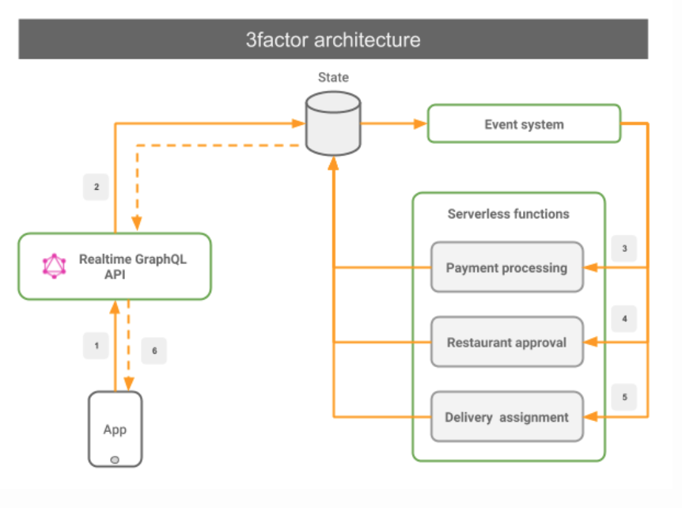
3 Factor App
Notes:
https://3factor.app/

Slide 19
Back-End Players
Change Data Capture “CDC”
IOT
Logstash, FluentD, Flume
Kinesis, Firehose, EventHub, DataFlow
Beam, Spark, Kafka Streams
AWS Lambda, Azure Functions
Machine learning

Slide 20
Front-End Players
Socket.IO, SignalR, GraphQL
Apollo
Notes:
Same tools!

Slide 21
Tips
Observability
Unit of Work / Single responsibility
DevOps, for real
Don’t fight the tools
Notes:
Joe Zack: * Coding Blocks
Software Engineer for Broadcom
Real-Time Analytics, I work with security events for very large organizations: Banks, Governments that have hundreds of thousands of computers, and billions of events. It's important to my customers that I detect problems as quickly as possible and I need to be able to quickly adapt when new threats are recognized.
Streaming is super cool, and worth your time
What
Why
How

Slide 22
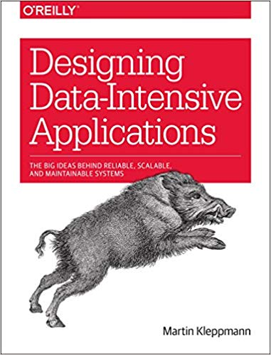
Resources
Notes:
Same tools!

Slide 23
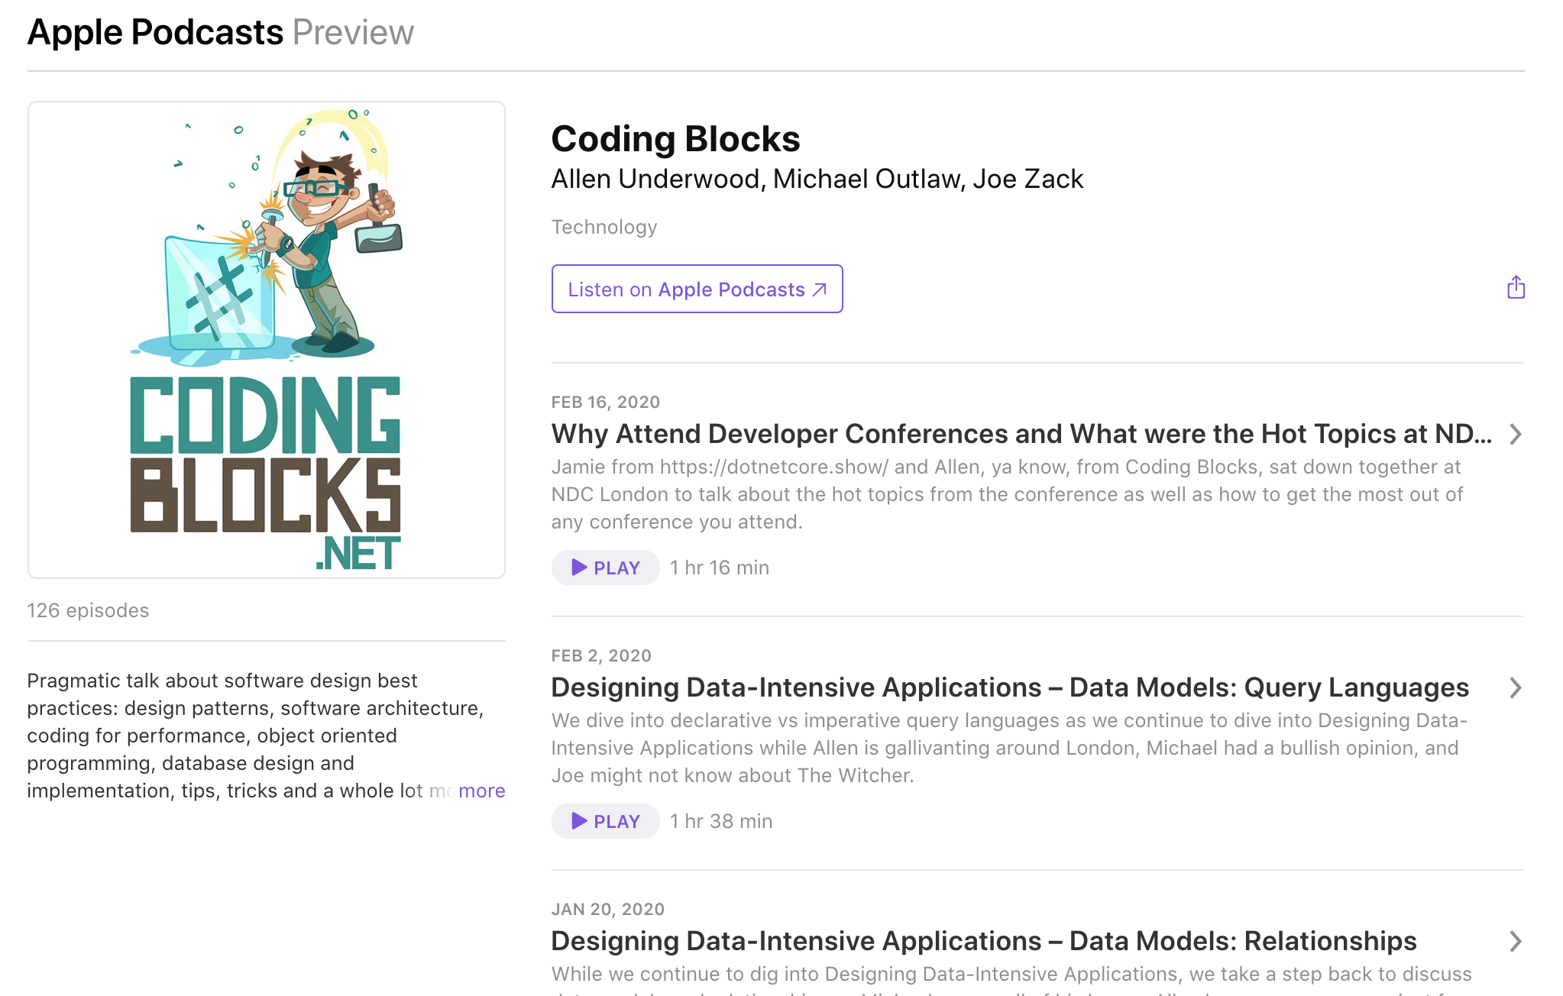
Notes:
Like this talk? Check out the show!

